Slide 1

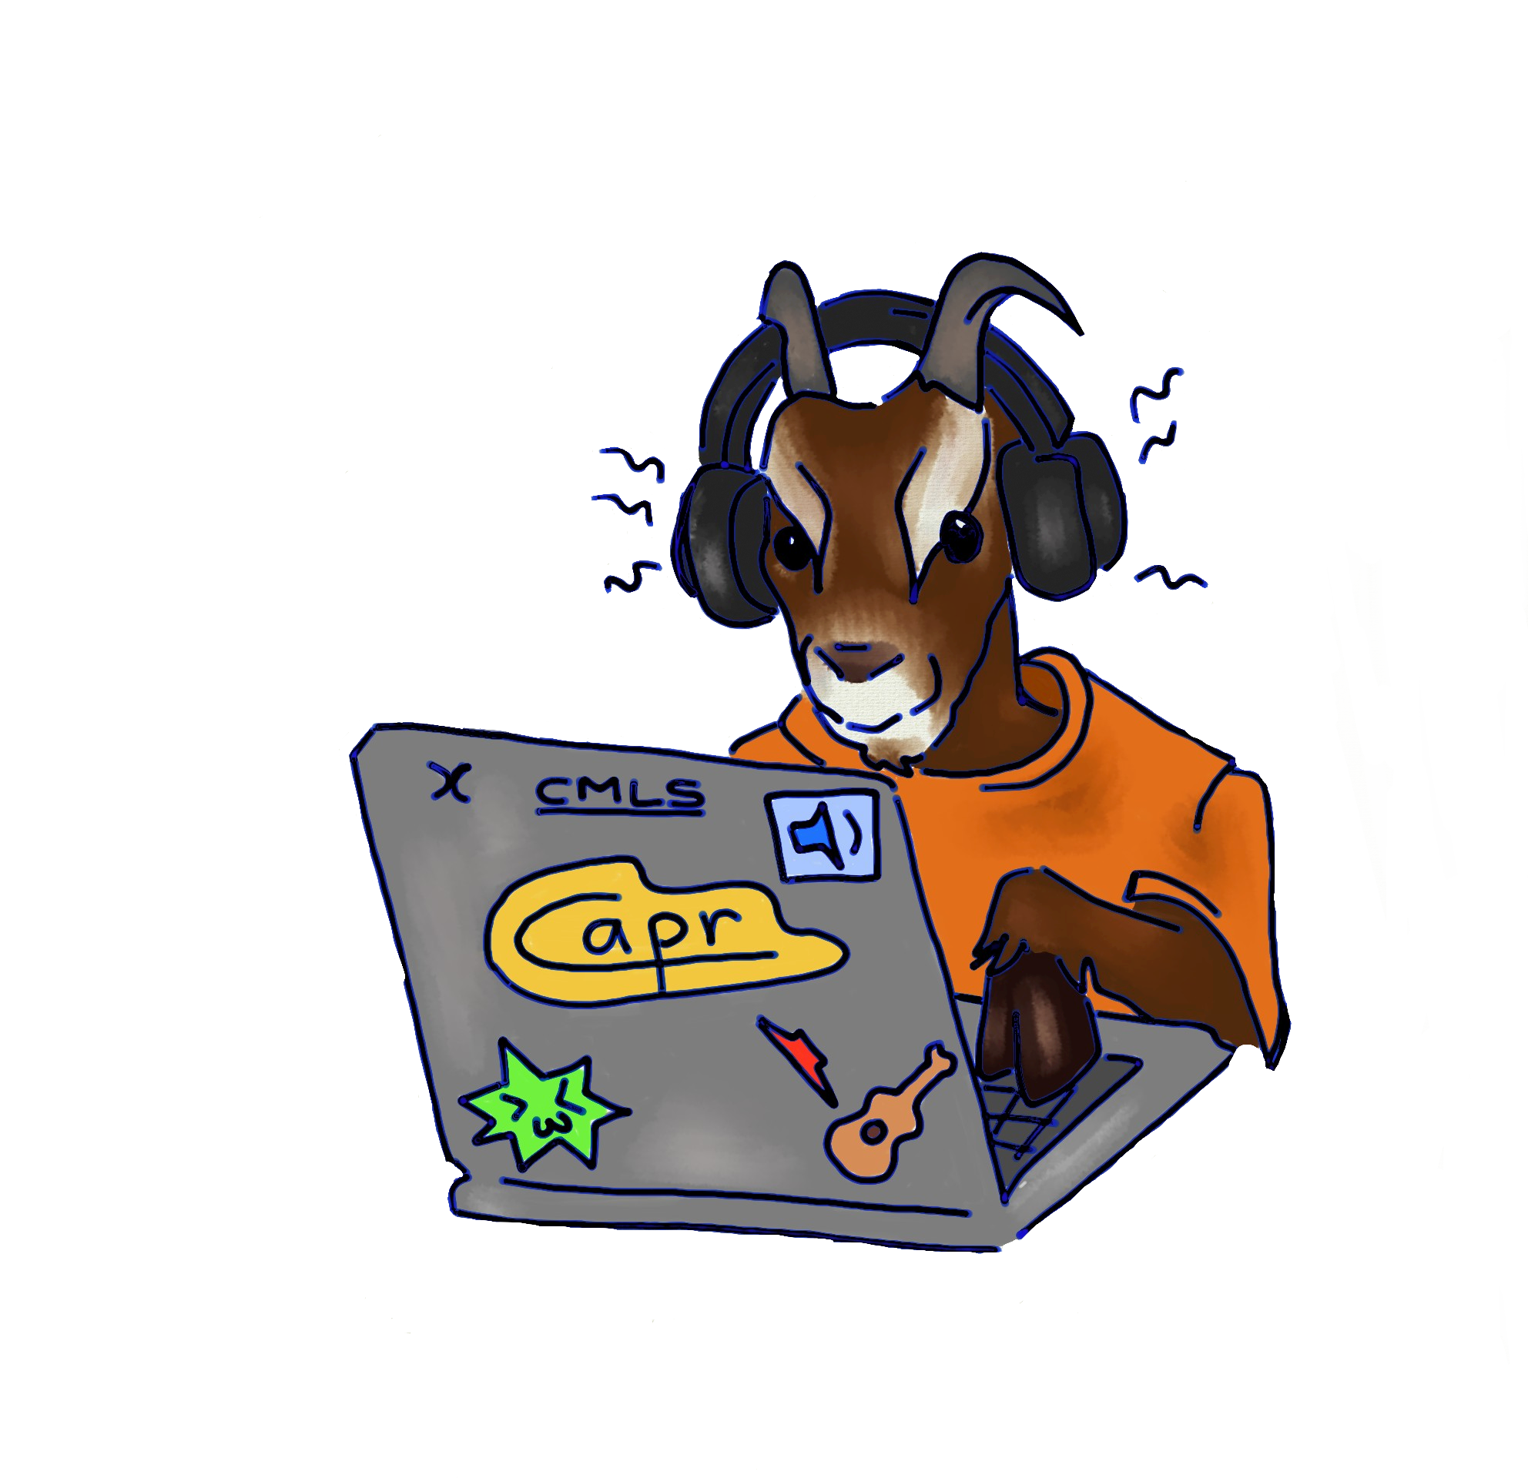
IL FRATTALATORE
Juce Homework assignment #4
Computer Music: Languages and Systems
Politecnico di Milano
Claudio Eutizi, Andrés Bertazzi, Pierluigi Tartabini, Riccardo Martinelli

Slide 2
Graphic User Interface

Slide 3
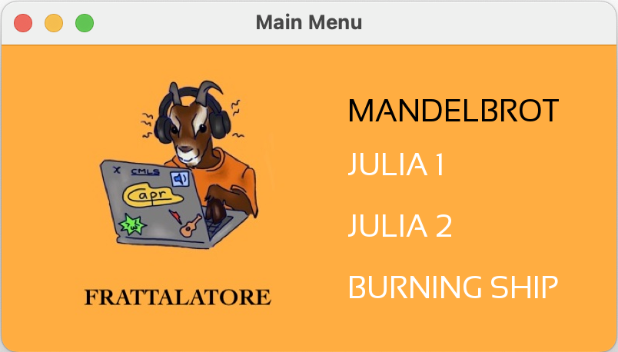
GUI
Menu Window

Slide 4
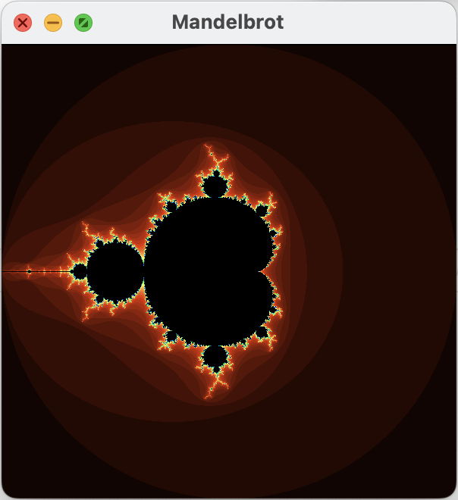
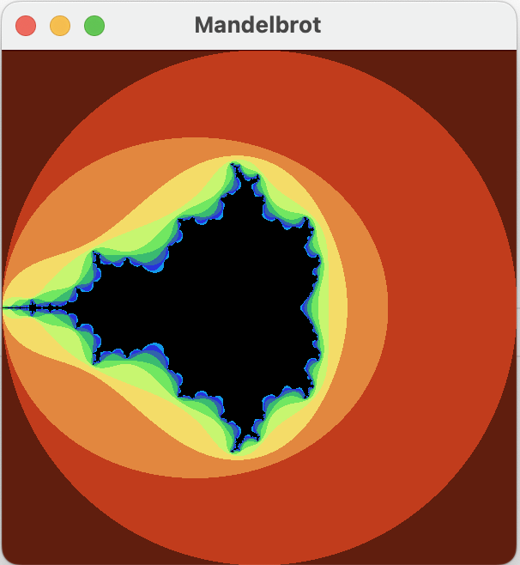
GUI
Fractal Images
1. Enter
2. Wheel Scroll

Slide 5
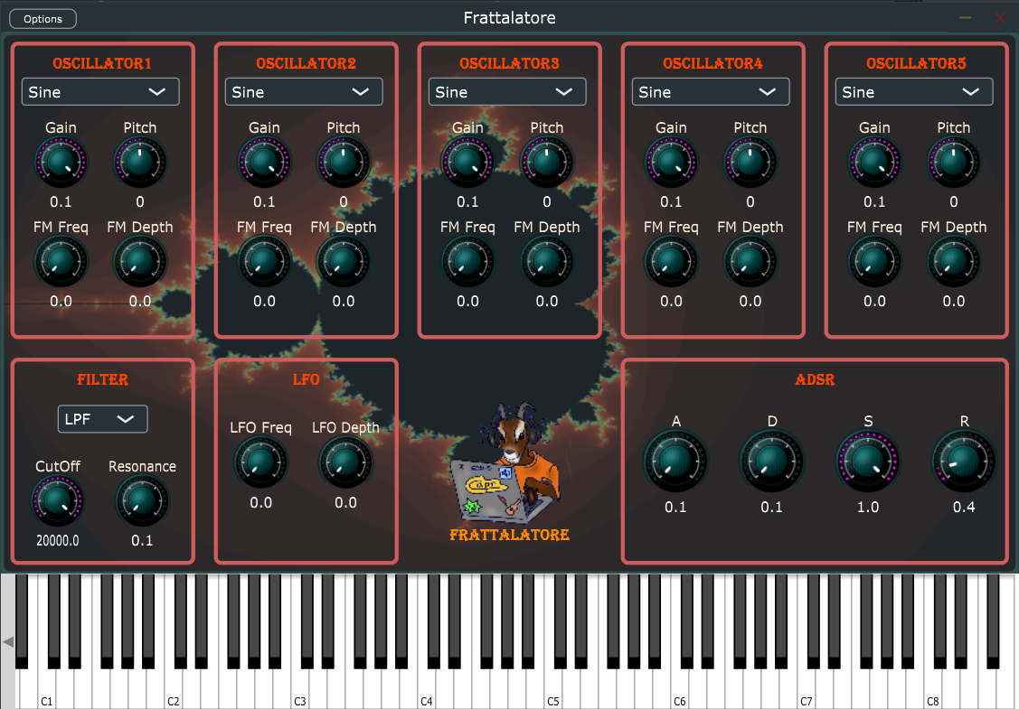
GUI
Synth Window
1. Oscillators
2. Filters
3. LFO
4. ADSR
5. Keyboard

Slide 6
Fractals

Slide 7
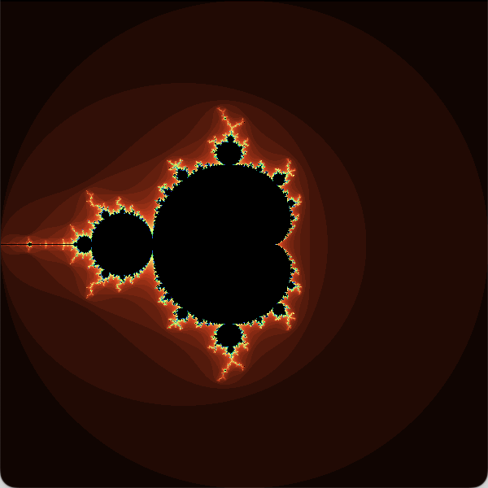
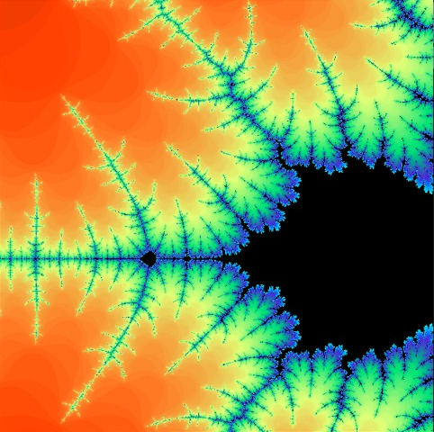
Fractals
Maldelbrot

Slide 8
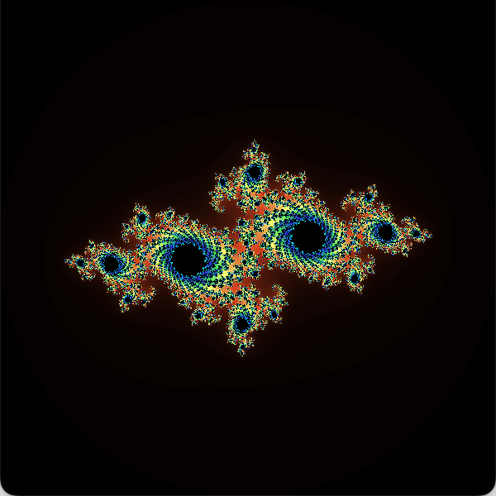
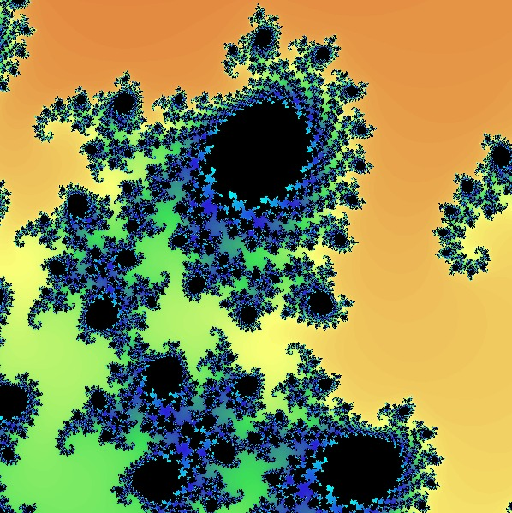
Fractals
Julia Set 1

Slide 9
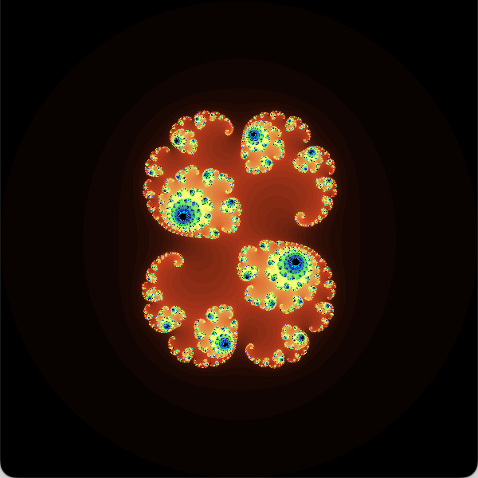
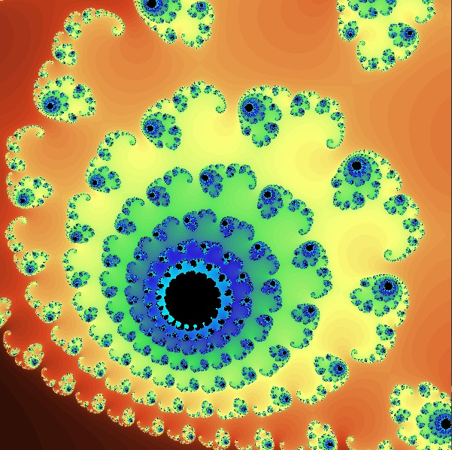
Fractals
Julia Set 2

Slide 10
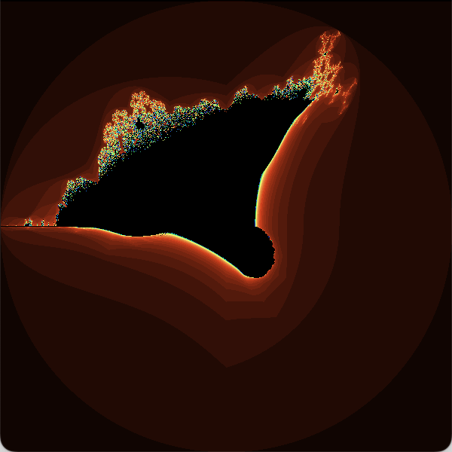
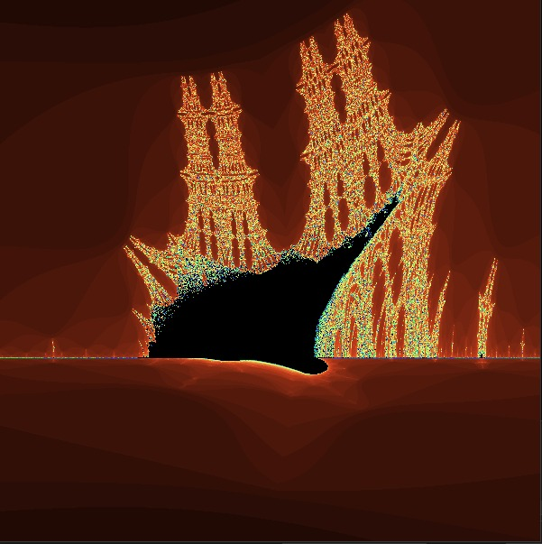
Fractals
Burning Ship

Slide 11
OSC Messages

Slide 12
Frattalatore Synthesizer

Slide 13
Synthesizer
Components

Slide 14
Synthesizer
Data

Slide 15
Synthesizer
Synth Voice

